Slide 1
Unit-9 Networking and Multithreaded Programming
Mr. Nilesh Parmar
Assistant Professor, Dept. of Computer Engg.
UVPCE, Ganpat University, Mehsana

Slide 2
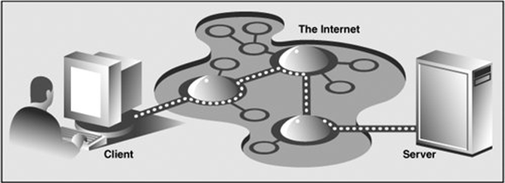
Client/Server Architecture
The server, a piece of hardware or software, is providing a "service" that is needed by one or more clients/users.
Client contacts a server for a particular request, send over any necessary data, and wait for the server to reply.
Now a days, a user or client computer is retrieving information from a server across the Internet/network.

Slide 3
Two levels of access
Python provides two levels of access to network services.
Low level: At this level you can access the basic socket support in the underlying operating system, which allows you to implement clients and servers for both connection-oriented and connectionless protocols.
Higher level: Python also has libraries that provide higher-level access to specific application-level network protocols, such as FTP, HTTP, SMTP and so on.

Slide 4
Sockets
Sockets are the endpoints of a bidirectional communication channels.
Sockets are used to establish communication within a process, between processes on the same machine, or between processes on different continents.
There are different types of sockets: Unix domain sockets, TCP sockets, UDP sockets etc.
Python has built-in ‘socket’ module which provides required classes and methods required for communication.
Socket Programming is a way of connecting two nodes through sockets on a network to communicate with each other.
Here, we create programs that enables two sockets to send and receive data, bi-directionally, at any given moment.
Sockets make the transfer of information possible between two different programs or devices. For example, when you open up your browser, you as a client are creating a connection to the server for the transfer of information.

Slide 5
Cntd…
Sockets are a combination of an IP address and a Port. A single device can have ‘n’ number of sockets based on the port number that is being used.
User can use any random number ranging between 0 to 65535 except port numbers 0 to 1023 which are reserved for privileged services and designated as well-known ports.
List of common port numbers and related protocols is given below:
Protocol | Common function | Port No | Python module
HTTP | Web pages | 80 | httplib, urllib, xmlrpclib
NNTP | Usenet news | 119 | nntplib
FTP | File transfers | 20, 21 | ftplib, urllib
SMTP | Sending email | 25 | smtplib
POP3 | Fetching email | 110 | poplib
IMAP4 | Fetching email | 143 | imaplib
Telnet | Command lines | 23 | telnetlib
Gopher | Document transfers | 70 | gopherlib, urllib

Slide 6
Why to use Sockets?
Internet-connected applications that need to operate in real time, gets good benefit from the implementation of sockets in their networking code. Some examples of apps that use socket programming are:
Web pages that show live notifications (Facebook, Twitch, eBay)
Multiplayer online games (League of Legends, WoW, Counter Strike)
Chat apps (WhatsApp, WeChat, Slack)
Realtime data dashboards (Robinhood, Coinbase)
IoT devices (Nest, August Locks)

Slide 7
Some Terminologies
Sr.No. | Term | Description
1 | Domain | The family of protocols that is used as the transport mechanism. These values are constants such as AF_INET, AF_UNIX, PF_INET, PF_UNIX, PF_X25, and so on.
2 | Type | The type of communications between the two endpoints, typically SOCK_STREAM for connection-oriented protocols and SOCK_DGRAM for connectionless protocols.
3 | Protocol | Typically its value is zero. It may be used to identify a variant of a protocol within a domain and type.
4 | Hostname | The identifier of a network interface − A string, which can be a host name, IPv4 address (in dotted format), or an IPV6 address in colon (or in dot) notation A string "<broadcast>", which specifies an INADDR_BROADCAST address. A zero-length string, which specifies INADDR_ANY, or An Integer, interpreted as a binary address in host byte order.
5 | Port | Each server listens for clients calling on one or more ports. A port may be a Integer number, a string containing a port number, or the name of a service.

Slide 8
socket module of Python
To create a socket, first import socket module then use the socket.socket() method available in socket module. General syntax for creating socket object is:
s = socket.socket (socket_family, socket_type, protocol=0)
Here is the description of the parameters:
socket_family − It specifies domain which is either AF_UNIX (address family: UNIX) or AF_INET (address family: Internet)
socket_type − It is either SOCK_STREAM or SOCK_DGRAM. SOCK_STREAM specifies connection oriented property and SOCK_DGRAM specifies connection- less property.
protocol − It may be used to identify a variant of a protocol within a domain and type. Either we ignore it or keep it 0.
Once you create a socket object, then you can access all the methods of socket module.

Slide 9
socket object built-in methods
Some of the socket object methods are used by server and some are used by client. Some methods are common for client & server.
Server socket methods are given below:
Client socket method is given below:
Sr.No. | Method | Description
1 | s.bind() | This method binds address (pair of hostname & port number) to socket.
2 | s.listen() | This method sets up and start TCP listener.
3 | s.accept() | This passively accept TCP client connection, waiting until connection arrives (blocking).
Sr.No. | Method | Description
1 | s.connect() | This method actively initiates TCP server connection.

Slide 10
Cntd…
List of common socket methods are given below. Common methods means it can be used by server and client both.
Example: Find ip address of www.google.com
Create one python file and write following code:
Sr.No. | Method | Description
1 | s.recv() | This method receives TCP message
2 | s.send() | This method transmits TCP message
3 | s.recvfrom() | This method receives UDP message
4 | s.sendto() | This method transmits UDP message
5 | s.close() | This method closes socket
6 | socket.gethostname() | This method returns the hostname.
import socket
ip= socket.gethostbyname('www.google.com')
print(ip)
Output:
216.58.199.164

Slide 11
Simple program using socket
Let us create a program which connects to Google server
Create a python file which has following content and Execute it :
import socket
s=socket.socket(socket.AF_INET, socket.SOCK_STREAM)
host_ip=socket.gethostbyname('www.google.com')
port=80
skt=(host_ip,port)
s.connect(skt)
print('successfully connected to:',skt)
Output:
successfully connected to: ('216.58.199.164', 80)
Creation of socket object
Getting the ip address of google.com
Creating socket which is pair of ip address and port number
Connecting to server of google.com

Slide 12
TCP client/server program
We are first creating a server socket object using socket function of socket module.
This server socket object uses bind(), listen() and accept() methods to communicate with client.
On the other side, one client socket object is created which uses connect() method to communicate with server.
Pseudo code for creating TCP Server:
ss = socket() # Create server socket object
ss.bind() # Bind socket to ipaddress & port
ss.listen() # Listen for connections
infinite_loop: # Server infinite loop
cs = ss.accept() # accept client connection
cs.send() # Send message to client
cs.close() # Close client socket object
ss.close() # Close server socket object
Pseudo code for creating TCP Client:
cs = socket() # Create client socket object
cs.connect() # Attempt server connection
cs.recv() # Receive message from server
cs.close() # Close client socket object

Slide 13
Creating TCP Server
TCP is a connection oriented protocol. So, value of socket_type will be SOCK_STREAM in socket method while creating socket object.
Create a file-‘server.py’. Contents of this file are: (Location: c:\Users\Nilesh\Desktop)
from socket import *
ss=socket(AF_INET,SOCK_STREAM)
host_name=gethostname()
port=900
skt=(host_name,port)
ss.bind(skt)
ss.listen(5)
while True:
cs,addr=ss.accept()
print('Got a request from:',addr)
msg='Thank you for contacting server.'
cs.send(msg.encode('ascii'))
cs.close()
ss.close()
Creation of server socket object
It gives hostname. Here, it is our own system.
Binding socket with server socket object
Server listens up to 5 clients
accept method returns client socket object and its socket (ip address + port)
Message is encoded in ASCII format before sending to client.
Note, here we use client socket object received using accept() method

Slide 14
Creating TCP Client
Create a file-‘client.py’. Contents of this file are: (Location: c:\Users\Nilesh\Desktop)
from socket import *
cs=socket(AF_INET,SOCK_STREAM)
host_name=gethostname()
port=900
skt=(host_name,port)
cs.connect(skt)
msg=cs.recv(1024)
cs.close()
print(msg.decode('ascii'))
Creation of client socket object
It connects to the server whose name is provided as host_name (currently, local host-our own system)
Client can receive up to 1024 bytes

Slide 15
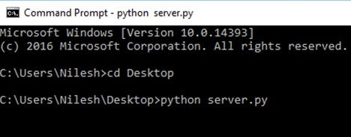
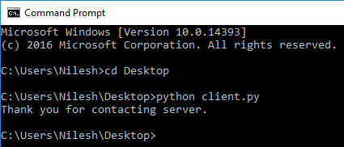
Cntd…
We need to run these codes in command prompt, because simultaneously we have to run 2 python programs, one server.py and second client.py:
When we execute server.py in CMD, it shows:
Open new command prompt and execute client.py, it shows:
You can see in the image that server is running for infinite time, as we have kept ‘while True’. Remember, Don’t close this window.
It is showing ‘Thank you for contacting server.’ This message is sent form server to client. (check code of server.py). Then client exits.

Slide 16
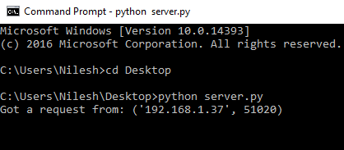
Cntd…
Surprising thing is, when you execute ‘client.py’, at that time server responds and ‘server.py’ code displays following message:
Remember, ‘client.py’ exits after getting server’s reply but ‘server.py’ is waiting to serve any request for infinite time.
To terminate execution of ‘server.py’ click:
Ctrl + c → for windows 7 and older Operating systems
Ctrl + Pause / Break key → for windows 10
Note: Here, server and client have same ip-address because server is- localhost
It shows that server has got a request from a system whose ip address is- 192.168.1.37 and port number is 51020.

Slide 17
Simple chat application
Most of the code and basic methods used in previous ‘server.py’ and ‘client.py’ are same.
To implement chat between one server and one client, we use sleep() method of module-time.
The sleep() method suspends execution of the current thread (process) for a given number of seconds.
Syntax: sleep(seconds)
Parameters :
seconds : Time in seconds for which the code is required to be stopped.
Returns: None

Slide 18
Concept of chat application
Server (server.py file)
Starting a server using bind(),
listen() and accept() methods.
Press ‘c’ to leave chat
Infinite_loop:
server sends message to client
time.sleep()
server receives message from client
close client & server socket
Client (client.py file)
Connect to a server using connect() method
Press ‘c’ to leave chat
Infinite_loop:
client receives message from server
client sends message to server
time.sleep()
close client socket

Slide 19
Contents of ‘server.py’: (Location: C:\Users\Nilesh\Desktop)
from socket import *
import time
ss=socket(AF_INET,SOCK_STREAM)
host_name=gethostname()
port=900
skt=(host_name,port)
ss.bind(skt)
ss.listen()
cs,addr=ss.accept()
print("Connected to client: ",addr[0])
print("Use characer 'c' to close chat")
while True:
msg=input('Me> ')
cs.send(msg.encode())
time.sleep(0.5)
msg=cs.recv(1024)
if (msg.decode()=='c'):
cs.send('c'.encode())
break
print('Reply>',msg.decode())
cs.close()
ss.close()

Slide 20
Contents of ‘client.py’: (Location: C:\Users\Nilesh\Desktop)
from socket import *
import time
cs=socket(AF_INET,SOCK_STREAM)
host_name=gethostname()
ip=gethostbyname(host_name)
port=900
skt=(host_name,port)
cs.connect(skt)
print("Connected to server: ",ip)
print("Use characer 'c' to close chat")
while True:
msg=cs.recv(1024)
if (msg.decode()=='c'):
cs.send('c'.encode())
break
print('Reply>',msg.decode())
msg=input('Me> ')
cs.send(msg.encode())
time.sleep(0.5)
cs.close()

Slide 21
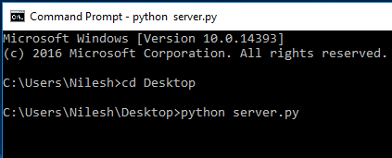
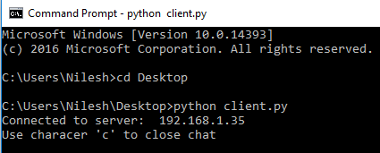
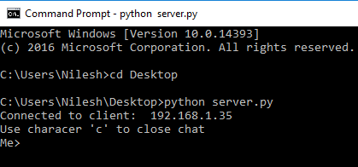
a
First start server by running ‘server.py’ in command prompt. Server is waiting for client.
Open new command prompt window. Execute client.py file. It starts a client and sends a request to server.
Whenever you start a client, server responds to the client. It is visible here.

Slide 22
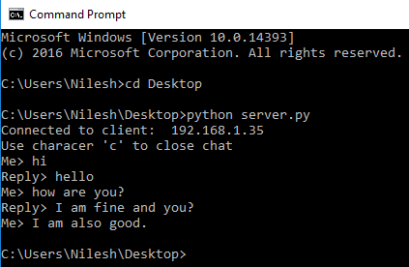
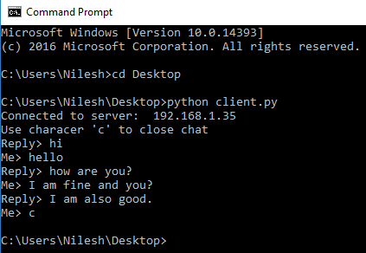
Chat between Server & Client. Messages from Server side.
a
Chat between Server & Client. Messages from Client side.

Slide 23
Thread & Processes
Process: Program in execution is called as process
Thread: It is a unit/segment of a process.
A process can have multiple threads.
Running several threads is similar to running several different programs concurrently, but it has the following benefits:
Multiple threads within a process share the same data space with the main thread and can therefore share information or communicate with each other more easily than if they were separate processes.
Threads are sometimes called light-weight processes and they do not require much memory overhead; they are cheaper than processes.

Slide 24
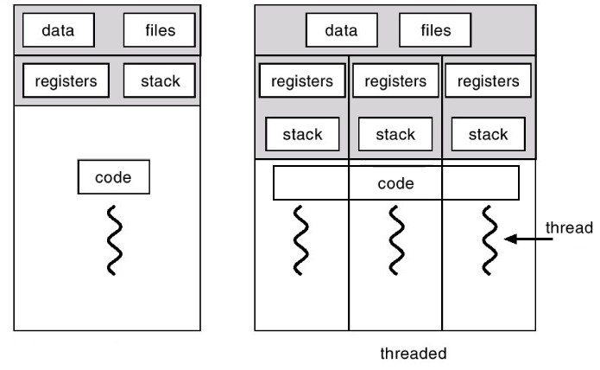
Cntd…
A thread has a beginning, an execution sequence, and a conclusion. It has an instruction pointer that keeps track of where within its context is it currently running.
It can be pre-empted (interrupted).
It can temporarily be put on hold (also known as sleeping) while other threads are running - this is called yielding.
There are two different kind of threads:
kernel thread
user thread
Kernel threads are a part of the operating system, while the User-space threads are not implemented in the kernel.

Slide 25
Cntd…
There are two modules which support multithreading in Python3:
_thread
threading
“thread” module of Python2 has been renamed to "_thread" in Python3 for backwards compatibilities.
We will use newer threading module for our examples, because it provides much more powerful, high-level support for threads than the _thread module.
The threading module exposes all the methods of the _thread module and provides some additional methods.

Slide 26
threading module
threading. active_count() − Returns the number of thread objects that are active.
threading.current_thread() − returns the current thread in execution. Using this method, we can perform particular actions with the obtained thread.
threading.enumerate() − Returns a list of all thread objects that are currently active.
In addition to the methods, the threading module has the Thread class that implements threading. The methods provided by the Thread class are as follows :
run() − The run() method is the entry point for a thread.
start() − The start() method starts a thread by calling the run() method.
join([time]) − The join() method enables a program to wait for threads to terminate.
isAlive() − The isAlive() method checks whether a thread is still executing.
getName() − The getName() method returns the name of a thread.
setName() − The setName() method sets the name of a thread.

Slide 27
Cntd…
Steps to implement a new thread using the <threading> module:
Define a new subclass of the Thread class.
Override the __init__(self [,args]) method to add additional arguments.
Then, override the run(self [,args]) method to implement what the thread should do when started.
Once you have created the new Thread subclass, you can create an instance of it.
Start a new thread by invoking the start(), which in turn calls the run() method.

Slide 28
Simple multithreading program
Let us consider a program which exhibits multithreading:
from threading import *
from time import *
class mythread(Thread):
def __init__(self,ids,nm):
Thread.__init__(self)
self.id=ids
self.name=nm
def run(self):
for i in range(3):
print(self.name,ctime())
th1= mythread(1,"thread-1")
th2= mythread(2,"thread-2")
th1.start()
th2.start()
th1.join()
th2.join()
print("Main thread complete.")

Slide 29
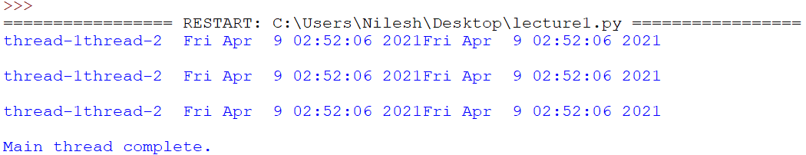
Cntd…
Output by executing previous codes:
Here, you can see that threads are racing with each other to run its own code.
Output of your program may be slightly different than this output, as per the execution.

Slide 30
Synchronizing Threads
The threading module of python also includes a simple-to-implement locking mechanism that allows you to synchronize threads. A lock object is created by calling the Lock() method.
The acquire(blocking) method of the new lock object is used to force the threads to run synchronously. The optional blocking parameter enables you to control whether the thread waits to acquire the lock or not.
If blocking value is set to 0, the thread returns immediately with a 0 value if the lock cannot be acquired and with a 1 if the lock was acquired.
If blocking is set to 1, the thread is blocked until the lock to be released.
The release() method of the lock object is used to release the lock when it is no longer required.

Slide 31
Code which shows synchronization achieved through locking mechanism in threads:
from threading import *
from time import *
class mythread(Thread):
def __init__(self,ids,nm):
Thread.__init__(self)
self.id=ids
self.name=nm
def run(self):
lock.acquire()
for i in range(3):
print(self.name,ctime())
lock.release()
lock=Lock()
th1= mythread(1,"thread-1")
th2= mythread(2,"thread-2")
th1.start()
th2.start()
th1.join()
th2.join()
print("Main thread complete.")

Slide 32
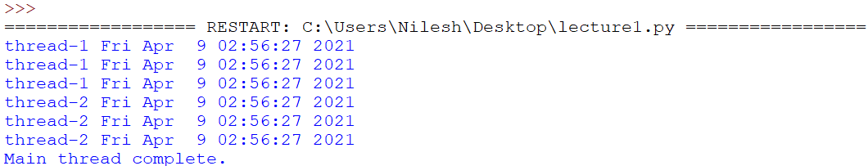
Cntd…
Output of previous code is shown in image given below. In output, you can see that execution of thread-2 starts only after completion of thread-1 due to synchronization. This synchronization is achieved through locking technique.

Slide 33
Sending Email using SMTP(smtplib)
Simple Mail Transfer Protocol (SMTP) is a protocol, which handles sending an e-mail and routing e-mail between mail servers.
Python provides smtplib module, which defines an SMTP client session object that can be used to send mail to any valid email id on the internet with an SMTP or ESMTP listener daemon.
Syntax to create one SMTP object, which is used while sending an e-mail:
sobj = smtplib.SMTP( [host [, port [, local_hostname]]] )
Where,
host: This is the host running your SMTP server. You can specifiy IP address of the host or a domain name like ‘smtp.gmail.com’. This is an optional argument.
port: If you are providing host argument, then you need to specify a port, where SMTP server is listening. Usually this port would be 25.
local_hostname: If your SMTP server is running on your local machine, then you can specify just localhost the option.

Slide 34
Cntd…
An SMTP object has an instance method called sendmail(), which is typically used to do the work of mailing a message. It takes three parameters −
sender − A string with the address of the sender.
receiver − A list of strings, one for each recipient.
message − A message as a string formatted as specified in the various RFCs (Request For Comment).
Remember, here we are using a Gmail account to send a mail. For that, port number is ‘587’. And if you want to send mail using other websites like yahoomail, hotmail, rediffmail then you need to get the corresponding information like IP address of the host / a domain name and port number.

Slide 35
Steps to send simple email from Gmail account
1) First of all, “smtplib” library needs to be imported.
2) Now, to create a session, we will use instance of SMTP class to encapsulate an SMTP connection.
s = smtplib.SMTP('smtp.gmail.com', 587)
Where, 1st parameter is the domain name and 2nd parameter is port number (here, port number of Gmail).
3) For security purpose, put the SMTP connection in TLS mode using method starttls(). TLS (Transport Layer Security) encrypts all the SMTP commands.
4) For security and authentication, login to Gmail using email id and password as parameters of login() method. This is the email id from which we will send an email.
5) Get sender, list of receivers and message. Message contains fields: From, To, Subject and content to be sent (body). Message is a multiline string of python.
6) Using the sendmail() method, send your message. sendmail() uses three parameters: sender, list of receivers and message. Here, message is the variable which we have defined in step-5. The parameters need to be in the same sequence.

Slide 36
Code to send emails is given below:
import smtplib
smtpob=smtplib.SMTP('smtp.gmail.com',587)
smtpob.starttls()
smtpob.login("nileshparmar0355@gmail.com",“xxxxxxxxx")
sender='nileshparmar0355@gmail.com'
receiver=['nap02@ganpatuniversity.ac.in’,‘parmar.cute@gmail.com’]
message="""From: {0}
To: {1}
Subject: Bulk email
This is a test e-mail message.
I want to say something
Are you listening? """.format(sender, ','.join(receiver))
smtpob.sendmail(sender,receiver,message)
smtpob.quit()
Email id through which we will send email
Password
List of receivers

Slide 37
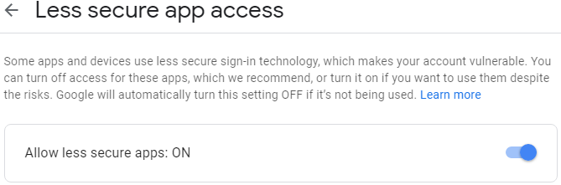
Cntd…
Before we run previous code, we need to change some settings.
Login to Gmail using email id from which you want to send email.
Open URL: https://www.google.com/settings/security/lesssecureapps
It will display content like this:
Turn “Allow less secure apps” option ‘ON’
Important Note: Turning this option ON is not recommended, so after you finish sending email, Turn it OFF again.

Slide 38
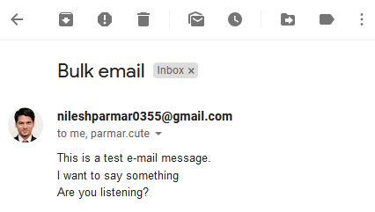
Cntd…
Execute previously written code just like other codes.
If code successfully executes, then open Gmail using email id to which you have sent email. Check out inbox, you will see a new email like this:
This way, we can send email using one email id to other email id.

Slide 39
Send an HTML e-mail using Python
When you send a text message using Python, then all the content is treated as simple text. Even if you include HTML tags in a text message, it is displayed as simple text and HTML tags will not be formatted according to the HTML syntax.
However, Python provides an option to send an HTML message as actual HTML message.
While sending an e-mail message, you can specify MIME version, content type and the character set as a part of Message variable.

Slide 40
Code to send a HTML email:
import smtplib
smtpob=smtplib.SMTP('smtp.gmail.com',587)
smtpob.starttls()
smtpob.login("nileshparmar0355@gmail.com",“xxxxxxxx")
sender='nileshparmar0355@gmail.com'
receiver=['nap02@ganpatuniversity.ac.in','parmar.cute@gmail.com']
message="""From: {0}
To: {1}
MIME-Version: 1.0
Content-type: text/html
Subject: SMTP HTML e-mail test
This is an e-mail message to be sent in HTML format
<b>This is HTML message.</b><i>It is sent using module <u>smtplib.</u></i>
<h1>This is headline.</h1>
""".format(sender,','.join(receiver))
smtpob.sendmail(sender,receiver,message)
smtpob.quit()

Slide 41
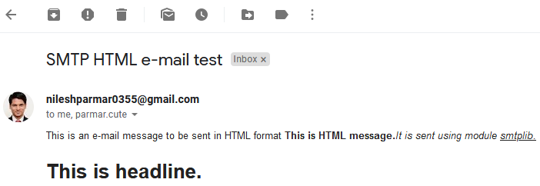
Cntd…
When you run previously given code, it will display like this:

Slide 42
Send email with attachment
Steps to send email with attachments from Gmail account:
For adding an attachment to email, you need to import built-in python libraries like- smtplib, email and its sub modules.
First, create an instance named ‘msg’ of MIMEMultipart class.
Mention the sender’s email id, receiver’s email id and the subject in the “From”, “To” and “Subject” key of the created instance “msg”.
Write body of email in a multiline string and assign to variable “body”. Now, attach the “body” to instance “msg” using attach() function.
Open the file you wish to attach in “rb” mode. Then create an instance named ‘part’ of MIMEApplication class with two parameters. First parameter is string containing the raw byte data and second parameter is filename. “Content-Disposition” is a header which indicates if the content is expected to be displayed inline in the browser, that is, as a web page or as part of a web page, or as an attachment, that is downloaded and saved locally.
Attach instance “part” to instance “msg” using attach() method.
We have already studied further steps of sending email in previous examples.

Slide 43
Code for sending attachment as email:
import smtplib; from email.mime.multipart import MIMEMultipart; from email.mime.text import MIMEText
from email.mime.application import MIMEApplication
msg=MIMEMultipart()
sender='nileshparmar0355@gmail.com'; receiver='nap02@ganpatuniversity.ac.in'
msg['From']=sender; msg['To']=receiver; msg['Subject']='Testing email with attachment'
body="""This is a plain text.
This email contains attachment."""
msg.attach(MIMEText(body))
file=open('C:/Users/Nilesh/Desktop/nba.txt', "rb")
part = MIMEApplication(file.read(),Name='nba.txt')
part['Content-Disposition'] = 'attachment; filename="%s"' %'nba.txt'
msg.attach(part)
smtpob=smtplib.SMTP('smtp.gmail.com',587)
smtpob.starttls()
smtpob.login("nileshparmar0355@gmail.com",“xxxxxxxxxx")
text=msg.as_string()
smtpob.sendmail(sender,receiver,text); smtpob.quit()

Slide 44
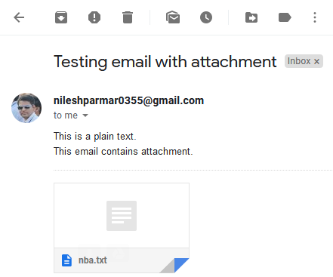
Cntd…
When you run previously given code, it shows:
Important Note: Turn “Allow less secure apps” option OFF again.

